Slide 1


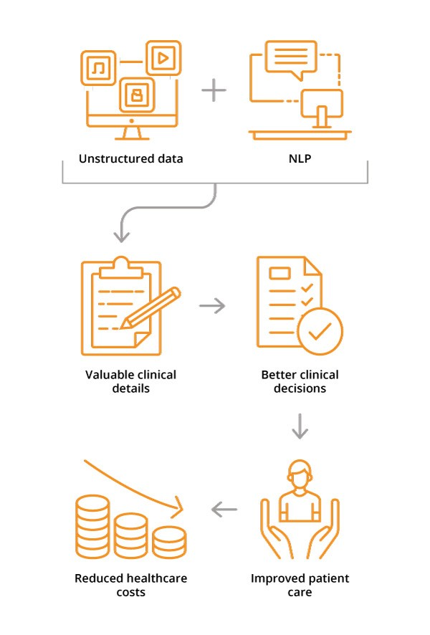
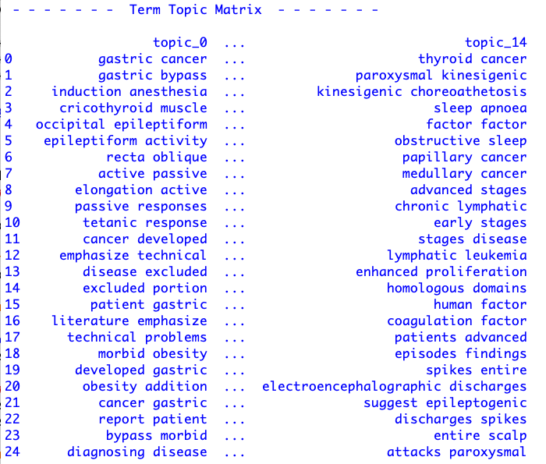
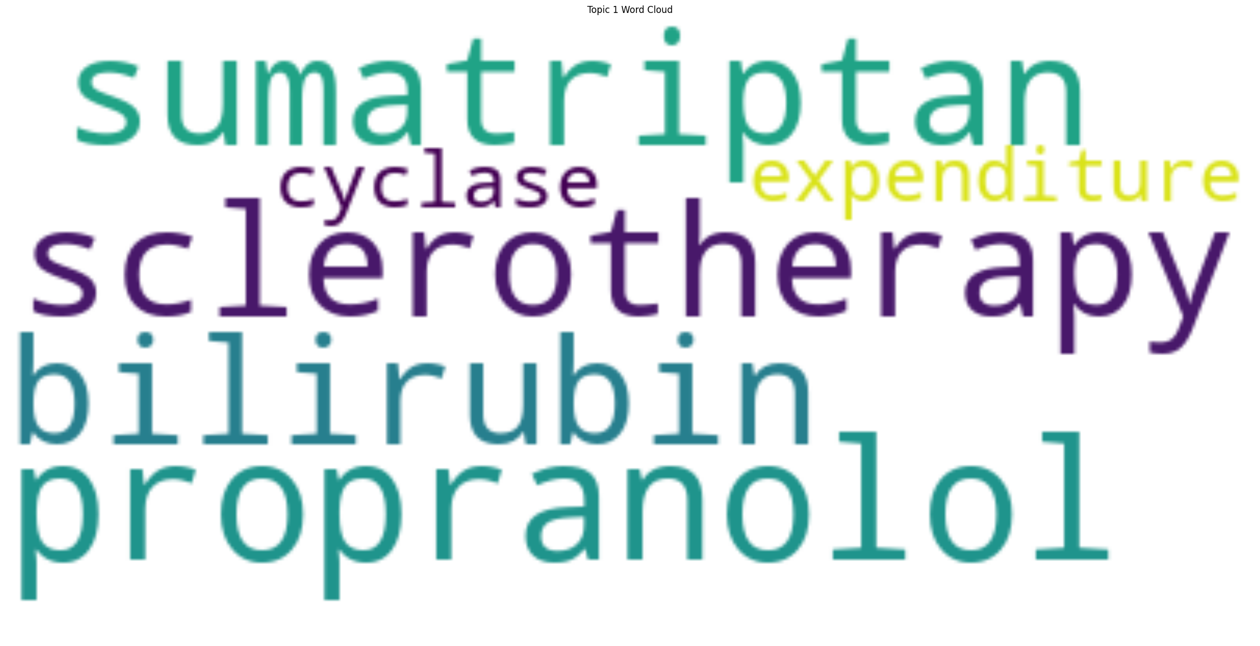
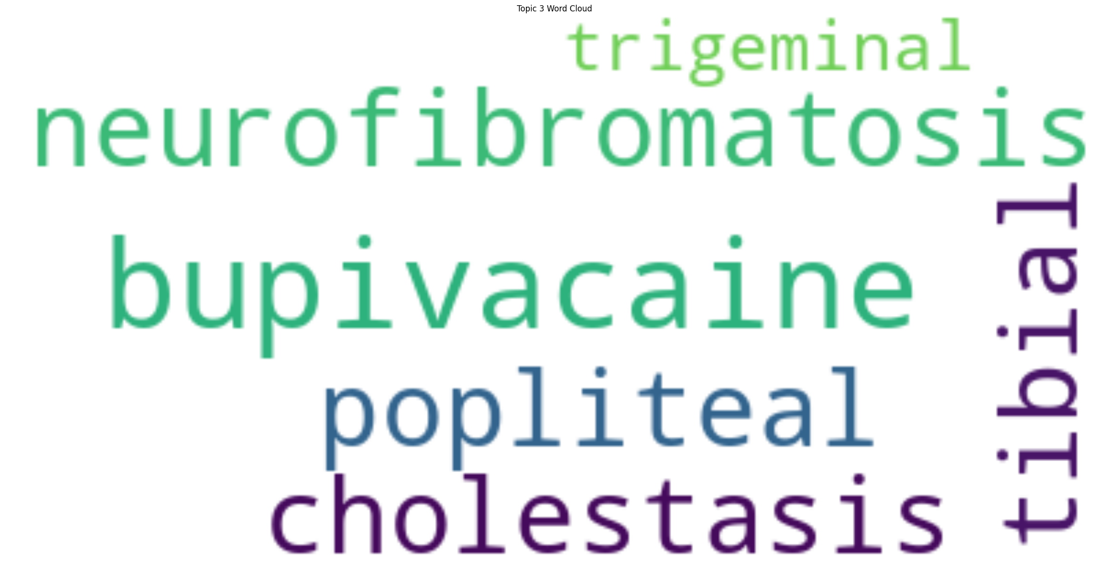

A Study of Artificial Intelligence and Machine Learning in Healthcare Information Technology : A Novel Approach to Medical Content Enrichment
Student: Katherine Jijo
Faculty Advisor: Dr. Steven C. Lindo, DPS. MSc
Abstract
Objectives
Discussion
The exponential growth of unstructured healthcare data poses a challenge in extracting actionable insights for healthcare professionals. This study aims to leverage Artificial Intelligence (AI), Machine Learning (ML), Natural Language Processing (NLP), and technologies to highlight latent topical features that would inform Healthcare Professionals.
Research Questions:
Part I: Can we discover hidden or latent topical mixtures in medical abstracts using the unsupervised machine learning algorithm, Latent Dirichlet Allocation (LDA)? Then can we overlay medical ontologies to enrich the latent topics and discover new relationships and insights that can enrich the medical abstracts?
Part II: Can we use the enriched medical abstracts to provide a guided search and navigation system for medical professionals? The system disambiguates medical terms from the abstracts and thus enforces a common vocabulary and alignment across.
This research project focused on Part I of the research questions.
Train an AI/ML model using Latent Dirichlet Allocation (LDA) to discover a term-topic matrix as a mixture of terms over latent topics.
Overlay the MeSH & SNOMED medical ontologies and taxonomies over the latent topics to create a weighted term-topic matrix and document-topic matrix.
Draw conclusions regarding the efficacy of AI/ML-driven approaches in facilitating more efficient and insightful healthcare information exploration
Analysis of the bi-gram term-topic matrix discovered LDA on the medical abstracts had noteworthy findings:
Applications can take advantage of the enriched term-topic matrix to facilitate a common understanding of medical terminology's contextual relevance during search or information retrieval.
Enhanced Relevance and Contextual Importance:
By using AI/ML techniques to enrich the term-topic matrix overlayed with insights from MeSH and SNOMED APIs, we were able to build a term-topic matrix of medical information, enriched with semantic meaning from SNOMED and categorized by MeSH for relevance.
Methods
Implications:
The findings underscore the potential of advanced AI/ML methodologies in healthcare informatics, particularly in:
Information Retrieval:
Demonstrates content enrichment methods with advanced algorithms that overlay medical ontologies, enhancing retrieval within healthcare.
Common Language and Terms:
The contextual relevance and insights created suggest its potential as a valuable tool for clinical decision-making, research, and education within healthcare by using a common language and disambiguating terms.
Data Collection and Sources:
The dataset comprises a corpus of 14,442 medical abstracts sourced from healthcare repositories, encompassing a broad range of patient diagnoses and treatments.
Latent Dirichlet Allocation for Discovering Latent Topics:
The corpus was first tokenized into unigrams (and again with bi-grams), and then using scikit-learn’s TFIDF Count Vectorizer, a bag-of-words (BoW) model was created to fit/train the LDA model. It is worth mentioning that as part of the pre-processing, stop-words, and other punctuation was removed. After tuning the hyperparameters of the LDA algorithm to perform topic modeling on the unstructured medical text corpus, it generates a term-topic & document-topic matrix capturing underlying themes within the corpus, facilitating subsequent analyses.
Integration of MeSH and SNOMED API
A Python program was created to take as input the term-topic matrix and integrate the MeSH and SNOMED APIs to retrieve relevant medical descriptors associated with the specified terms.
Background
Medical records and texts are often more subjective than objective. Many healthcare professionals are working in an EHR system (Electronic Health Record), entering diagnoses, treatments, status, updates, and notes, and do not use the same terms and standardized vocabulary when entering information. The absence of shared terminology, standardized diagnoses, and treatments can lead to patient care being delayed or lost.
The intuition behind this research is that by overlaying medical industry-controlled vocabularies and taxonomies over a machine learning model trained by medical abstracts, it may guide healthcare professionals to “sing from the same sheet of music”. Therefore they can use the correct terms and labels, enabling and enhancing semantic search capabilities for better patient outcomes.
LDA Model Hyperparameters:
LatentDirichletAllocation(batch_size=5, evaluate_every = 1, learning_method = 'online', max_iter=20,n_components=15, random_state=42)
Future Directions
Site A/B Development: Deploy the machine learning model and supporting data structures to create A/B test websites for use of medical professionals as a comparative study — Site A (not enriched) Site B (enriched).
Algorithmic Enhancements: Continue LLM integration and exploration of other advanced algorithms for additional meta-data and content enrichment.
Notes:
feel free to change background colors & text boxes and use sections for difference purposes!

